Slide 1
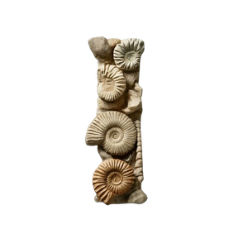
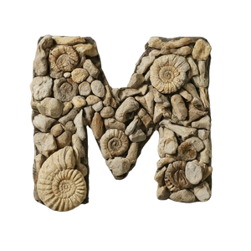
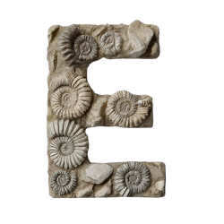
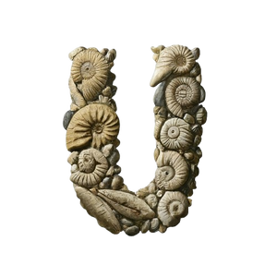
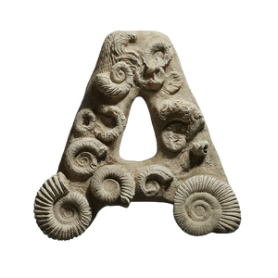
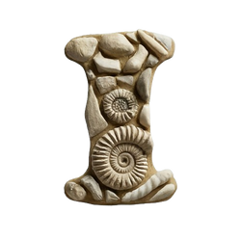

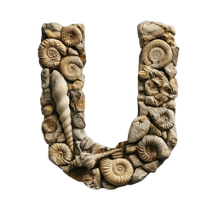
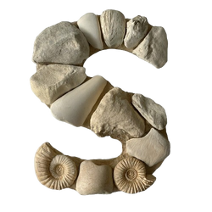
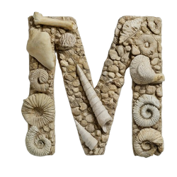
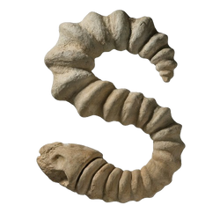
EXPLORING
EMMA ADAMS

Slide 2
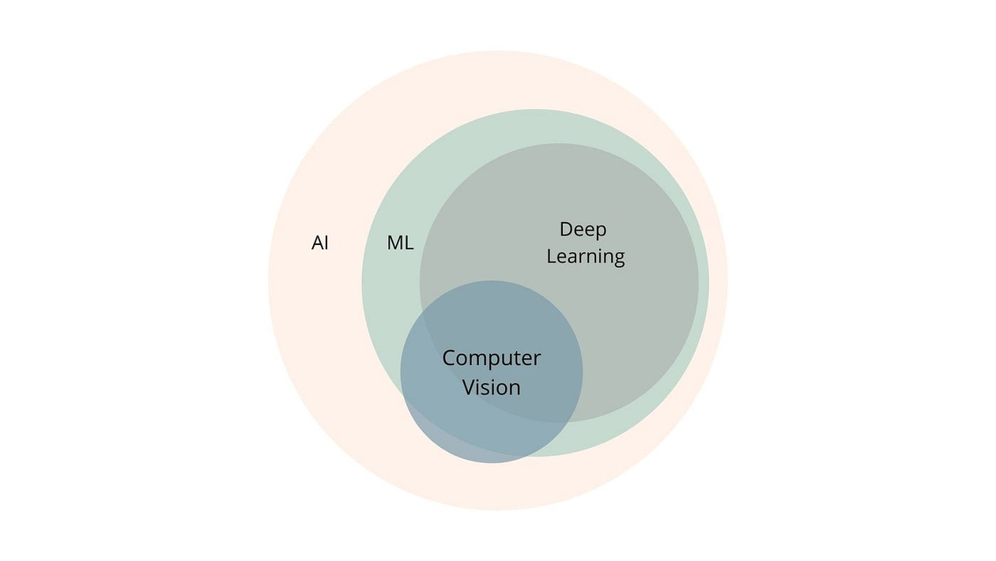
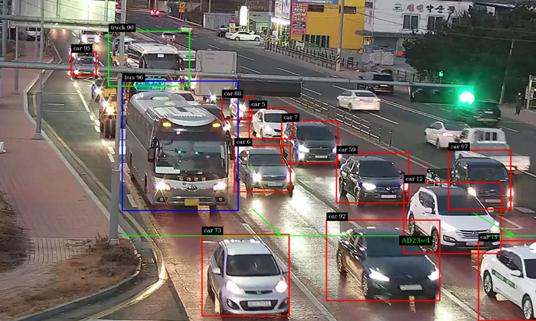
ARTIFICIAL INTELLIGENCE
Artificial intelligence is the concept that computers can replicate human intelligence and thinking.
Allowed for the creation of many tools, including:
Speech Recognition
Computer Vision
Large-Language Models (LLMS) or Text-Response Generators
Natural Language Processing (NLP)
Predictive Analysis

Slide 3





DIGITIZATION WITH AI
How can AI be utilized to optimize lengthy museum and archival processes to digitize dark data?
Optical Character Recognition
Multimodal AI & Generative AI
Image Classification

Slide 4
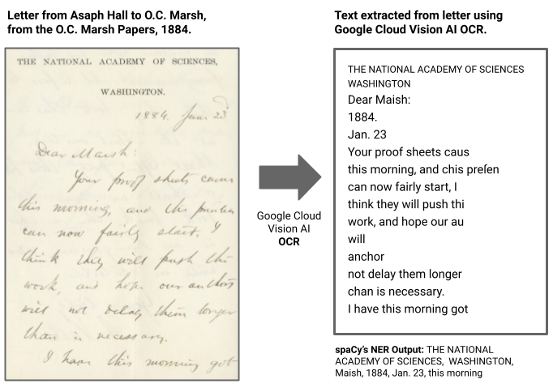

HANDWRITING RECOGNITION
Utilized Google Cloud Vision AI’s Optical Character Recognition (OCR) tool to extract text from the O.C. Marsh Papers.
OCR transcribes text from an image or file.
Named Entity Recognition (NER) extracts named entities from each document.
OCR is not yet perfect for handwritten (cursive) materials, but improvements are constantly being made.
Text
&
Entities

Slide 6
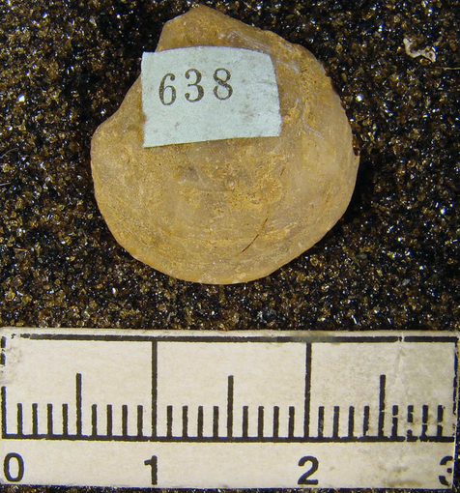

MULTIMODAL & GENERATIVE AI
Utilized Google Vertex AI to describe various labels on specimen in image files.
Multimodal AI takes input in varying data types and generates responses based on the inputs.
Generative AI (GenAI) is a form of AI that generates or creates content or data.
Google Vertex AI and multimodal AI works very well for this type of project, and it produces the correct text output. Requires a relatively standardized dataset.
“Identify the label on the specimen in the image, ignoring the ruler at the bottom, and extract the label’s text or numbers. Describe the label’s color, medium (paper, paint, etc.), and shape. Put in the format: numbers - description.“
638 - Rectangular white paper label.

Slide 7
EXPLORING
EMMA ADAMS

Slide 8
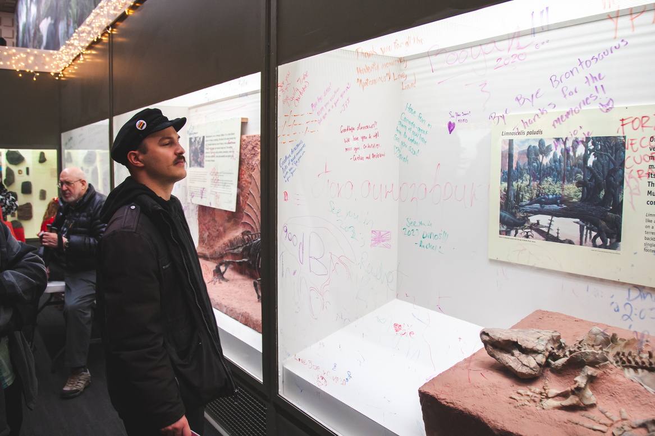

IMAGE CLASSIFICATION
Utilized Google’s Teachable Machine to classify images around the museum into various categories based on exhibit, time, and other categories.
Label Classification assigns tags or labels to images using AI.
Possible Exhibit Labels
David Friend Hall
Burke Hall
Great Hall
Central Gallery
Possible Time Labels
Pre-Renovation
Post-Renovation
Great Hall
Pre-Renovation

Slide 9
MOVING FORWARD
AI is not yet perfect, but improvements are being made daily.
Many new ways to utilize AI are being created.
Different forms of AI can be combined with each other or used alongside other existing technology to achieve a desired output.
Speech Recognition
Computer Vision & Optical Character Recognition
Large-Language Models (LLMS) or Text-Response Generators
Natural Language Processing (NLP)
Speech Recognition
Different forms of AI should be considered when re-evaluating existing digitization pipelines.

